Slide 1
Infosys Springboard Virtual Internship 6.0 Milestone - 2
- By Jampana Rahul Varma
Instructor – Shakti gopalakrishnan

Slide 2
Problem Statement
Air pollution in major cities like Delhi is rising.
People lack awareness of future air quality risks.
Existing apps show only current AQI, NOT future predictions.
No unified dashboard combining current pollutants, trends, prediction & analytics.

Slide 3
AirAware
AirAware is an intelligent air quality monitoring dashboard that analyzes historical pollution levels and predicts future Air Quality Index (AQI) trends for Delhi.
The system uses PM2.5-based AQI calculations and a lightweight trend-extrapolation algorithm to estimate AQI for the next 1 and 5 years.
It provides real-time simulated pollutant values (PM2.5, CO₂, NO₂), visual trend charts, a prediction bar graph, and a color-coded accuracy heatmap.
The interface is built entirely with HTML, CSS, and JavaScript, featuring a modern gradient UI and optional dark-mode toggle.
AirAware demonstrates how data analytics and predictive modeling can help communities understand pollution patterns and prepare for air-quality challenges.

Slide 4
Technologies Used:
HTML5
CSS3
JavaScript
Python
Libraries:
Bootstrap 5
Chart.js v4
Scikit-learn
Tensorflow

Slide 5
HTML:
Defines the structure and layout of the AirAware dashboard, including cards, sections, charts, and the navbar.
CSS:
Styles the UI with gradients, dark mode, spacing, heatmap colors, and visual enhancements for a clean modern interface.
JavaScript:
Handles AQI calculation, prediction logic, dynamic updates, theme toggle, heatmap generation, and interacts with charts.
Bootstrap:
Provides a responsive grid system, cards, buttons, and navbar components to quickly build a polished and mobile-friendly layout.

Slide 6
Chart.js:
Renders interactive line and bar charts for historical trends and AQI predictions with smooth animations and real-time theme updates.
Python:
Used to train Machine Learning models and Deep Learning models to predict air quality.
Scikit-learn:
Used to train machine learning models.
Tensorflow:
Used to train LSTM model.

Slide 7
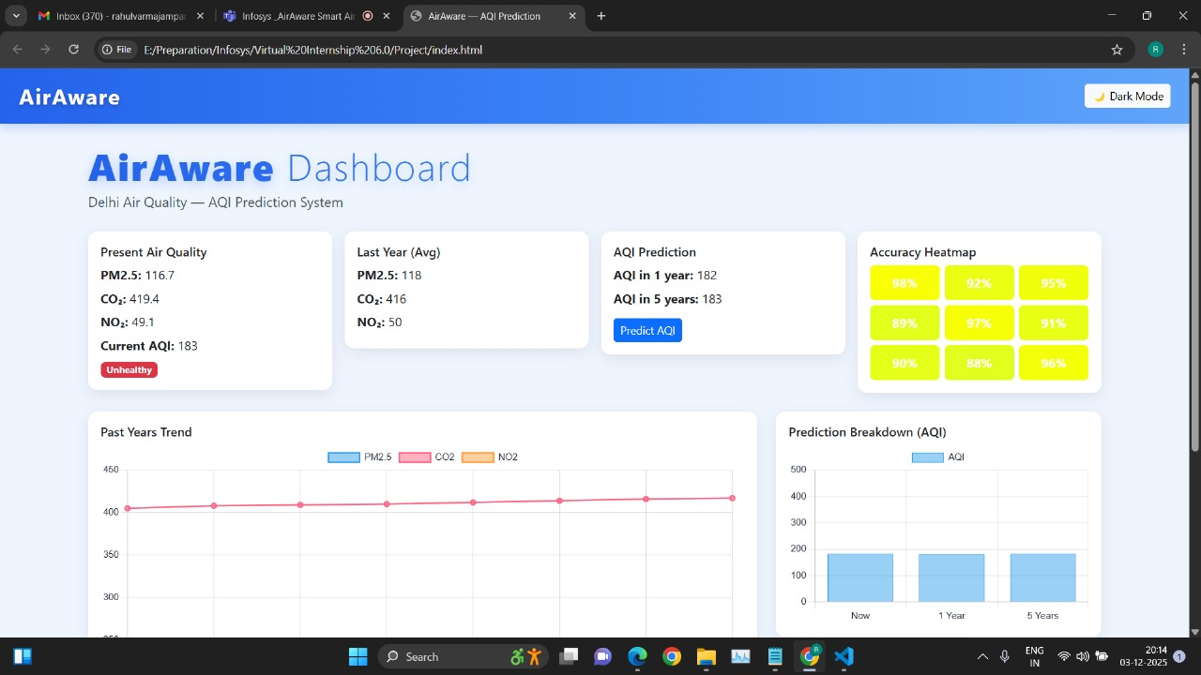

Slide 8
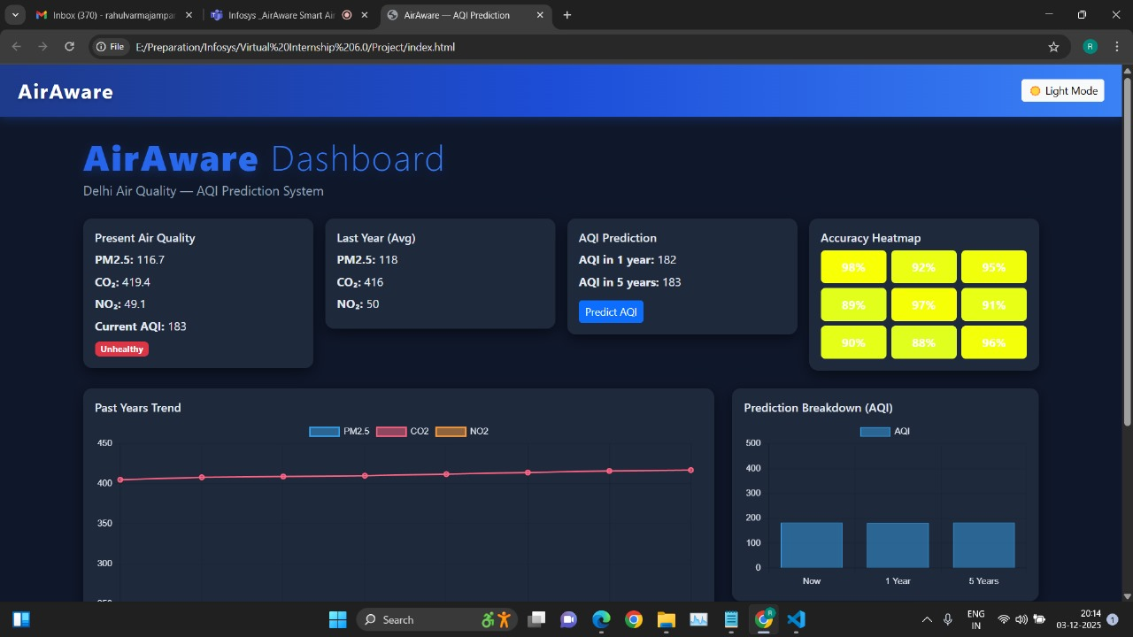

Slide 9
===== MODEL ACCURACIES (R² Score) =====
Linear Regression: 0.1511
Random Forest: 0.9970
Gradient Boosting: 0.9887
XGBoost: 0.9838
Best Model: Random Forest with Accuracy (R²): 0.9970
Model saved as: best_aqi_model.pkl

Slide 10
Objectives for Milestone 3:
Implement Backend using Python and connect it to frontend
Improve UI responsiveness
Integrate a chatbot in UI
Integrate a weather agent

Slide 11
THANK YOU

